Slide 1

JOB-SYNC:
A comprehensive style guide

Slide 2
Table of Contents
  Introductions...2
  Logo and App Icon...5
  Typography...6
  Colors...7
  Icons...8
  Don'ts...10
  Additional Information...11

Slide 3
Introduction
Job sync is an innovative platform designed to streamline job application process for applicants and it's able to enhance connections with hiring teams. It's a one way platform for job seekers and offering simple tools to simply searches, optimize resumes and provide personalized guides.
The platform focuses on providing seamless job search capabilities, personalized resume reviews, interview preparation and networking opportunities.
Any questions that need to be addressed can be directed to identity@JS.com.

Slide 4
Introduction Continued
Standard light mode and dark mode
We intend to implement the feature of having a complete light and dark mode respectively in our app.
Preparations
We will make sure our app is up to the complete standard before publishing the app, an app name and icon will be approved by JS and the backend team.

Slide 5




LOGO AND APP ICON
logo
As the main identifier for Job-Sync, this would be placed in the welcome page and this would be the only logo and app icon that should be used, so there should never be a problem with incorporating it in either a header or a footer.

Slide 6
JobSync Typography Guide
The typography for JobSync, with its bold gradient background transitioning from blue (#0097B2) to green (#7ED957), reflects a sleek, modern, and professional aesthetic while ensuring readability. The recommended font family for headings is Bebas Neue or Montserrat, styled in extra bold or black for a futuristic feel, with main titles ranging from 44–52px and section headers between 30–38px. For contrast, the primary heading color should be deep navy (#003366) or white (#FFFFFF). Subheadings should use Raleway or Open Sans in semi-bold or bold, sized between 22–26px, and colored teal (#008080) or light green (#A4E57A) to maintain a tech-forward vibe. Body text, set in Roboto or Lato with regular or medium weight, should be sized 16–18px and use dark gray (#333333) or black (#000000) for clarity. Text should dynamically adjust to maintain legibility on both dark and light sections of the gradient background. Callouts and highlights can use Poppins or Nunito in bold or italic, matching body text size but using electric blue (#0073E6) or vibrant green (#4CAF50) for accent colors. For quotes and testimonials, Merriweather or Georgia in italic should be used, sized 16–18px, with soft cyan (#A7E0E8) or off-white (#F5F5F5) colors for a subtle, distinguished look. Button text should be Montserrat or Bebas Neue, styled in bold, all caps, sized 16–18px, with white (#FFFFFF) text on a deep blue (#005A9E) or neon green (#00CC66) background to create a clear call to action. The typography guidelines emphasize ample spacing, clear alignment—left for text-heavy sections and center for headers or call-to-action elements—and a seamless integration with the bold, structured look of the JobSync logo. By combining high-contrast fonts, dynamic styling, and a cohesive layout, JobSync creates a modern, tech-forward aesthetic tailored to its audience.

Slide 7
Colors
These colors together create a vibrant, professional, and approachable feel for JobSync, helping it establish a strong brand identity that resonates with users looking for a reliable, forward-thinking job-search platform.

Slide 8
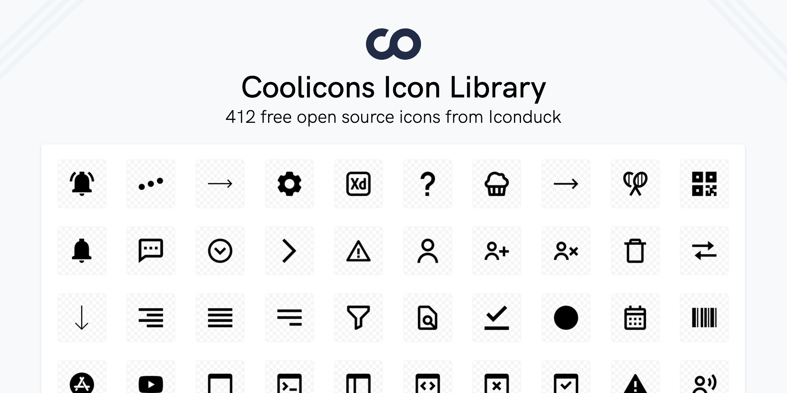
ICONS
The icons should be used from the coolicons library on Figma and the star ratings library in Figma. Any other miscellaneous icons will be located on the JOB-SYNC Primary website under development reference

Slide 9
Naming New App
App Icon
When naming a new app, please make sure that the following principles are applied.
The app Icon is the first impression and identity of the app and shall therefore represent the app's purpose. An app Icon is unique and exclusive for its app and shall not be used for other purposes or meanings. Hence, for each new app and icon created. Never use the JOBSYNC beta app icon.
Be in line with Job-Sync brand, express customer benefit, focus on the functionality of the app, be descriptive, follow industry practice., be consistent and most of all keep it short.

Slide 10
DON'TS
DON'T USE UNAPPROVED COLORS.
Don't reproduce any part of the of the JOB-Sync logo in any other color than it's original.

Slide 11
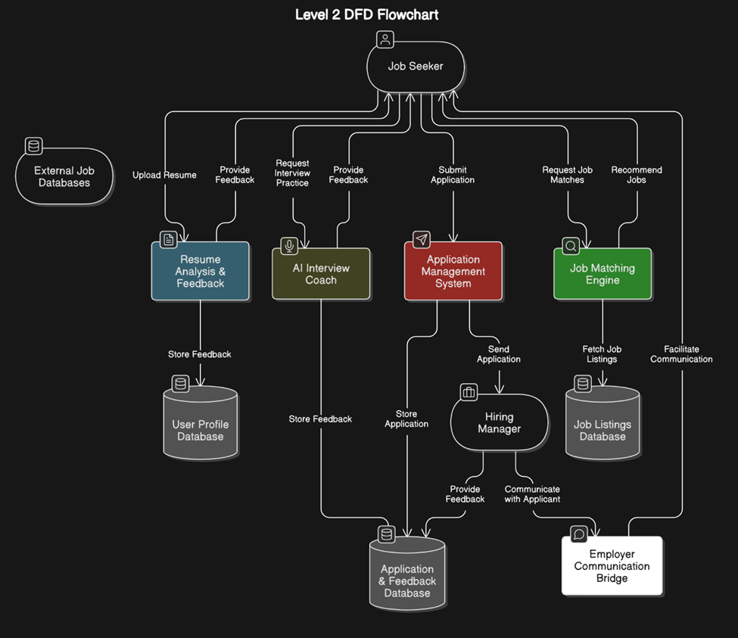

Slide 12
1. External Entities
Job Seeker: Users looking for jobs, submitting resumes, and applying for positions.
Hiring Manager: Employers who review applications, schedule interviews, and provide feedback.
External Job Databases: Sources like LinkedIn and Indeed where job listings are fetched.
2. Processes
2.1 Resume Analysis & Feedback: AI-powered system evaluates the user’s resume and suggests improvements.
2.2 Job Matching Engine: Uses machine learning to find suitable job postings based on the user’s profile.
2.3 Application Management System: Allows users to submit job applications and track their status.
2.4 AI Interview Coach: Provides real-time interview practice and feedback.
2.5 Employer Communication Bridge: AI chatbot helps facilitate interactions between applicants and hiring managers.
3. Data Stores
User Profile Database: Stores job seeker details, resumes, and application history.
Job Listings Database: Maintains job openings fetched from external sources.
Application & Feedback Database: Tracks applications, employer responses, and interview feedback.
4. Data Flow
Users upload resumes → Resume Analysis provides feedback.
Job Matching Engine recommends jobs → Users apply.
Applications are sent to hiring managers → Hiring managers review and respond.
Interview Coach helps applicants prepare → Feedback is stored.
AI chatbot facilitates communication between applicants and hiring managers.

Slide 13
Request for Quote (RFQ)
JobSync - AI-powered Resume Analysis and Feedback System
Date: 03/23/2025
Company: JobSync
Contact Information:
· Name: JobSync
· Email: support@jobsync.com
· Phone: 1-800-825-0000
1. Introduction
JobSync is an innovative job search application designed to streamline the hiring process. We aim to provide users with personalized feedback to improve their resumes and increase their chances of getting hired. We are seeking a vendor that can provide AI-powered natural language processing (NLP) services to analyze resumes and offer tailored improvement suggestions.
2. Project Overview
The objective of this RFQ is to procure an AI-powered resume analysis and feedback system that can be integrated into the Jobsync platform. This system must analyze resumes based on content, format, and industry-specific keywords, offering users actionable feedback for improvement.

Slide 14
3. Technical Requirements
· AI NLP Capabilities: Ability to scan resumes, identify keywords, and provide suggestions for improving content based on industry standards.
· Customization: The system should be customizable to analyze resumes for different industries (e.g., IT, healthcare, marketing, etc.).
· Integration: The solution must be capable of integrating seamlessly with our existing database structure and user interface.
· Real-time Feedback: Provide users with immediate, actionable suggestions for resume improvements.
· Data Privacy and Security: Ensure user data is processed securely and complies with relevant data protection regulations (e.g., GDPR, CCPA).
4. Vendor Requirements
· Proven experience in providing AI-powered resume analysis tools.
· Strong track record of successful integrations with mobile applications or web platforms.
· Ability to provide a live demo or prototype of the system before full implementation.
· Post-launch support, including bug fixes and system updates.

Slide 15
5. Submission Guidelines
Please submit the following along with your quote:
· Detailed technical proposal including an explanation of how the AI solution works.
· A timeline for project completion, including development phases and milestones.
· A cost breakdown, including any licensing fees, maintenance costs, and support services.
· Contact information for a project manager or account representative.
6. Evaluation Criteria
Proposals will be evaluated based on:
· Functionality and suitability of the AI-powered system.
· Integration capabilities with our platform.
· Pricing and overall value.
· Vendor reputation and experience.
7. Submission Deadline
Please submit your quote and proposal by [Insert Date].
8. Contact Information
If you have any questions or require clarification regarding this RFQ, please contact:
· Name: JobSync
· Email: support@jobsync.com
· Phone: 1-800-825-0000

Slide 16
Find Your Dream Job Faster & Smarter!
What is JobSync?
JobSync is a sleek and efficient job-searching app designed to streamline the hiring process, enhance communication between job seekers and employers, and provide AI-driven tools for career success.
Key Features
AI-Powered Resume Analysis – Get instant feedback and optimization tips.
Smart Job Matching – Personalized recommendations based on your skills and experience.
Direct Employer Communication – Chat with hiring managers directly through the app.
Real-Time Application Tracking – Stay updated on the status of your applications.
Interview Preparation Tools – AI-generated practice questions and mock interviews.
Seamless Resume & Profile Management – Upload, edit, and send resumes with ease.

Slide 17
Why Use JobSync?
🚀 Faster Hiring Process – No more waiting weeks for responses.
💡 More Opportunities – Connect with top companies and recruiters.
🎯 Increased Visibility – Get noticed by employers actively seeking candidates.
📊 Data-Driven Insights – Track how often your profile is viewed and improve your applications.
How It Works
1️ Sign Up & Create Your Profile – Upload your resume and set job preferences.
2️ Explore Personalized Job Listings – Get AI-powered job recommendations.
3️ Apply & Communicate with Employers – Track applications and get real-time responses.
4️ Ace Your Interviews – Use AI-powered tools to prepare and stand out.
📲 Download JobSync Today!
Join thousands of job seekers who are landing jobs faster than ever before.
🔗 Website: www.jobsync.com
📧Contact Us: support@jobsync.com
📱Follow Us on Social Media: @JobSyncOfficial

Slide 19
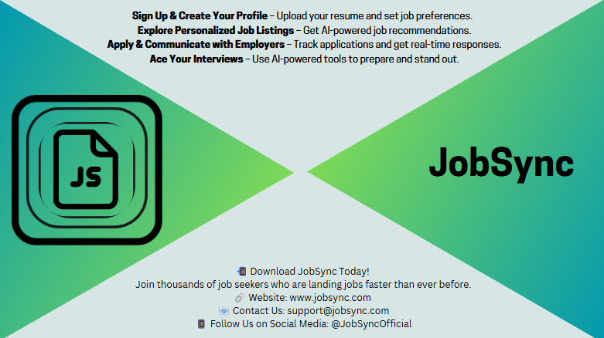

Slide 20
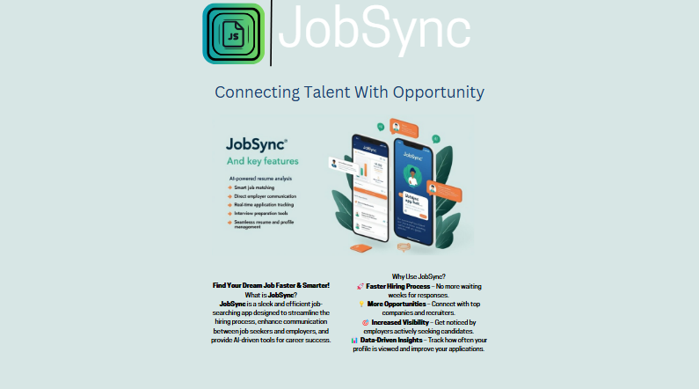

Slide 21
Additional Information
  If you have any questions, comments, concerns or complaints regarding stylistic details, please contact us at:
support@jobsync.com
Or
  Marcus3.jones@famu.edu

